Slide 1
Visual studio 2010 web.config transformation
Jay Smith – Tyson Foods, Inc.

Slide 2
Agenda
The Corporate Development Environment
Deployment Challenges
Deployment Strategy 1
Deployment Strategy 2
Deployment Strategy 3
VS 2010 Web.config Transformations

Slide 3






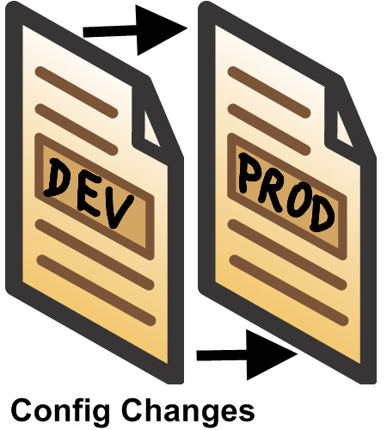







The Corporate Dev Environment
Copy Web
Publish Web
IIS7
Developer
Internet

Slide 4
Deployment Strategy 1

Slide 5
DEMO 1
Using command files to modify configuration for different environments

Slide 6
Deployment Strategy 2

Slide 7
DEMO 2
Using command files to modify configuration for different environments

Slide 8
Deployment Strategy 3

Slide 9
DEMO 3
Using command files to modify configuration for different environments

Slide 10





VS 2010 web.config Tranformation
XML Transformation Engine
(Staging Ready)
Web.Staging.Config
Outputted to OBJ\staging folder of your project

Slide 11



XML Transformation Engine
Web.Staging.Config
(Staging Ready)

Slide 12
DEMO 4
How Visual Studio 2010 web.config transformation solves the problem

Slide 13
Summary

Slide 14
Resources

